Slide 1
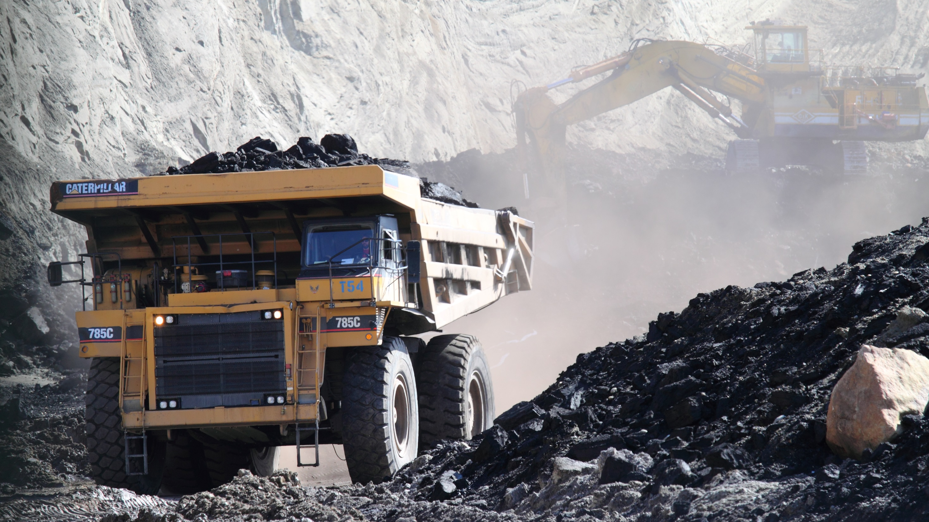
Innovation in coal mining
Maksim Lavrentev
Higman, B., McKittrick E., Active coal mining at Two Bull Ridge, Ground Truth Trekking, photograph, viewed December 2016 http://www.groundtruthtrekking.org/photo/active-coal-mining-at-two-bull-ridge_3/

Slide 2



Coal plays a vital role in global economy
COAL
2.5
OIL
3.2
GAS
1 Tton
Coal industry is undergoing significant changes
Global coal consumption, Billion TOE (BP, 2015)
Asia is driving growth of coal production
Consumption in Europe is declining due to switch to unconventional energy resources
Energy security concerns force development of domestic resources and alternative energy
Coking coal will sustain high demand, while thermal might loose its share
Alderman, 2013; BP, 2015; Fikkers, 2013; Hao et al. 2015; Osborne et al., 2013

Slide 3


Innovations in coal mining are mostly of incremental type
Coal companies’ technology development:
Mining companies utilize adaptor strategy
Effect from economy of scale is diminishing
In-house R&D expenditure account for 4-8 % of revenues and has been decreasing
Recent innovations:
Since 1990 a few radical innovations occurred: long haul extraction, continuous mining, draglines and some other
Incremental innovations increased efficiency and intensity of operations
Economy of scale in mining – Haul trucks
Over the period of 35 years, haul trucks have increased in size by 10 times, at the same time the cost of the haulage has decreased by 72 %
1970
1990
2005
Bartos, 2007; Hitzman, 2002

Slide 4
Cooperation with RTOs advances technology development in coal mining
Sources of innovation in coal industry
In-house R&D
RTOs
Scientific community
Provide incremental innovations
Maintain level of expertise
Provide incremental and radical innovations
Operate on global level
Decrease diffusion time and costs
Generate new knowledge
Envision direction for technology development
Thurner & Zaichenko, 2014

Slide 5
Innovation in coal mining is driven by strengthening regulations and market growth
To continue growing, coal mining has to:
Comply with emerging Health, Safety and Environmental regulations
Increase efficiency and productivity of processes
Spheres that are targeted for changes
Technologies that enable changes
Sensing technologies & Internet of Things – will allow remote, real-time monitoring, diagnostics and prognostics
Automation of machinery – will allow remote control of the processes without direct human intervention
Combination of processes – synergetic effect will increase efficiency
Extraction
Processing
Supply chain
Utilization (power plants)
Waste recycle
Lien, 2013; Osborne et al., 2013; Ralston et al, 2014; Yu-fang & Jin-xing, 2011

Slide 6
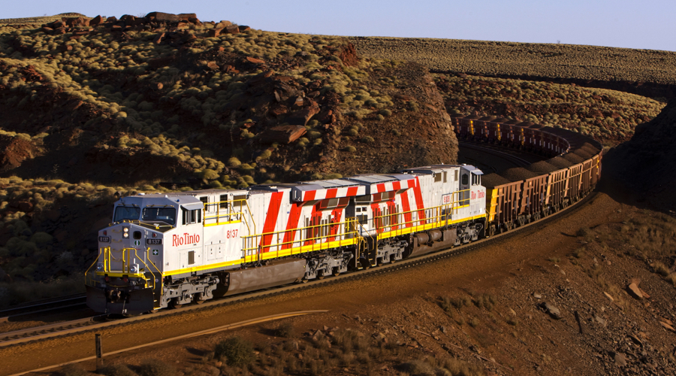

Example of innovation in mining – Rio Tinto open pit mining
Rio Tinto owns Pilabara iron ore mine in Western Australia
Launched first projects on automation of mining in 2008
Introduced fully automated operations with driverless haul trucks and trains
Remotely controls operations from Perth 1300 km away
Delivers ore at 450 km distance of with driverless trains
Core technologies utilized:
Sensing technologies
Satellite communications
Artificial intelligence
Robotics
All of the technologies can be transferred to coal mining processes
Lien, 2013

Slide 7
Example of innovation in coal processing and utilization – Polygeneration plants
Polygeneration plants are under development in Australia, China, Japan, Europe, Canada and the USA
Polygeneration plants produce
Electricity
At least one of the chemical products: hydrogen, SNG, ammonia, methanol, dimethyl ether and other liquids from the syngas
Efficiency is greatly increased due to:
Supply network redesign
Synergetic effects
Waste and emissions capture, reuse and recycle
Osborne et al., 2013

Slide 8
Summary
Coal industry has a big influence on local and global economy
The future of coal mining relies on innovation activity for increase of efficiency and regulations compliance
The industry has witnessed mostly incremental innovations recently; radical a rare
Significant role in generating innovations is being undertaken by RTOs that enable rapid changes due to technology transfer and faster diffusion
Current innovations are directed at all processes in coal supply chain: from mining to utilization

Slide 9
Bibliography
Alderman, J. K. (2013). Future industrial coal utilization: forecasts and emerging technological and regulatory issues. The coal handbook: Towards cleaner production Volume 2: Coal utilisation. Woodhead Publishing Limited. http://doi.org/10.1533/9781782421177.1.85
Bartos, P. J. (2007). Is mining a high-tech industry ? Investigations into innovation and productivity advance, 32, 149–158. http://doi.org/10.1016/j.resourpol.2007.07.001
BP,. (2015). BP Statistical Review of World Energy 2015. London: BP Statistical Review of World Energy. Retrieved from http://www.bp.com/statisticalreview
Fikkers, A. (2013). Coal resources, production and use in established markets. The coal handbook: Towards cleaner production Volume 2: Coal utilisation. Woodhead Publishing Limited. http://doi.org/10.1533/9781782421177.2.105
Hao, Y., Zhang, Z., Liao, H., & Wei, Y. (2015). China ’ s farewell to coal : A forecast of coal consumption through 2020. Energy Policy, 86, 444–455. http://doi.org/10.1016/j.enpol.2015.07.023
Lien, L. (2013). Advances in coal mining technology. The coal handbook: Towards cleaner production Volume 2: Coal utilisation. Woodhead Publishing Limited. http://doi.org/10.1533/9780857097309.2.193

Slide 10
Bibliography (continued)
Osborne, D. G., Sharples, M., Lien, L., Schumacher, G., Babich, A., Harris, D., & Carras, J. (2013). Future directions toward more efficient and cleaner use of coal. The coal handbook: Towards cleaner production Volume 2: Coal utilisation. Woodhead Publishing Limited. http://doi.org/10.1533/9781782421177.3.497
Ralston, J., Reid, D., Hargrave, C., & Hainsworth, D. (2014). Sensing for advancing mining automation capability : A review of underground automation technology development. International Journal of Mining Science and Technology, 24(3), 305–310. http://doi.org/10.1016/j.ijmst.2014.03.003
Thurner, T., & Zaichenko, S. (2014). Research and Technology Organizations ( RTOs ) in the primary sector Providing innovation to Russia ’ s mines. European Journal of Innovation Management, 17(3), 292 – 310. http://doi.org/10.1108/EJIM-04-2013-0031
Yu-fang, L., & Jin-xing, S. (2011). Using the Internet of Things Technology Constructing Digital Mine. Procedia Environmental Sciences, 10, 1104–1108. http://doi.org/10.1016/j.proenv.2011.09.176

